Slide 1
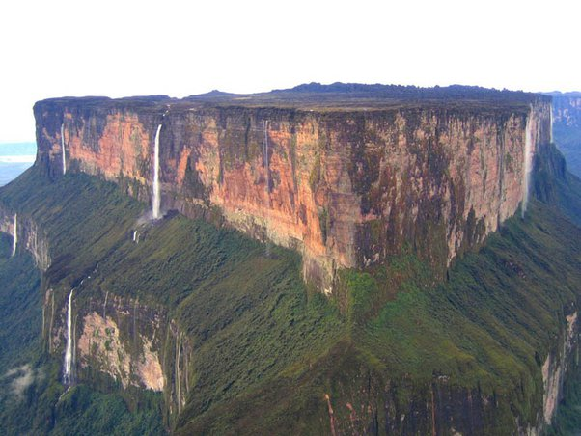
My Project Age of Geeona
The Adventure Through Geeona
By James Alexander David Hayward

Slide 2
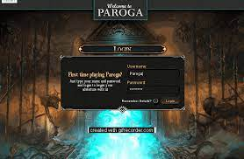
Log in Screen?
WELCOME TO GEEONA
Would like to implement
Will only start the timer when logged in

Slide 3
Game Basics
The game will take you on a journey through the lands of Geeona, answering questions and making decisions to face the boss at the volcano

Slide 4
The Owl
The owl is the guide throughout the game
He will give you hints on how to play the game, and tell you if have have made a mistake or found a shortcut!

Slide 5
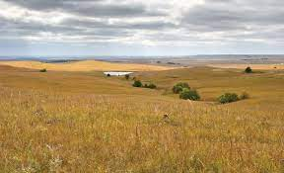

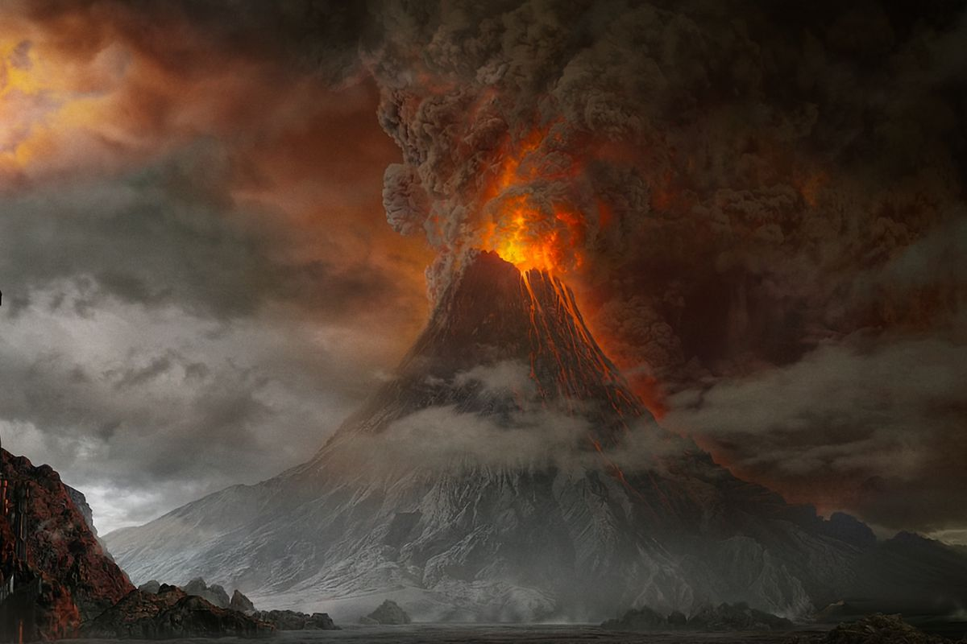
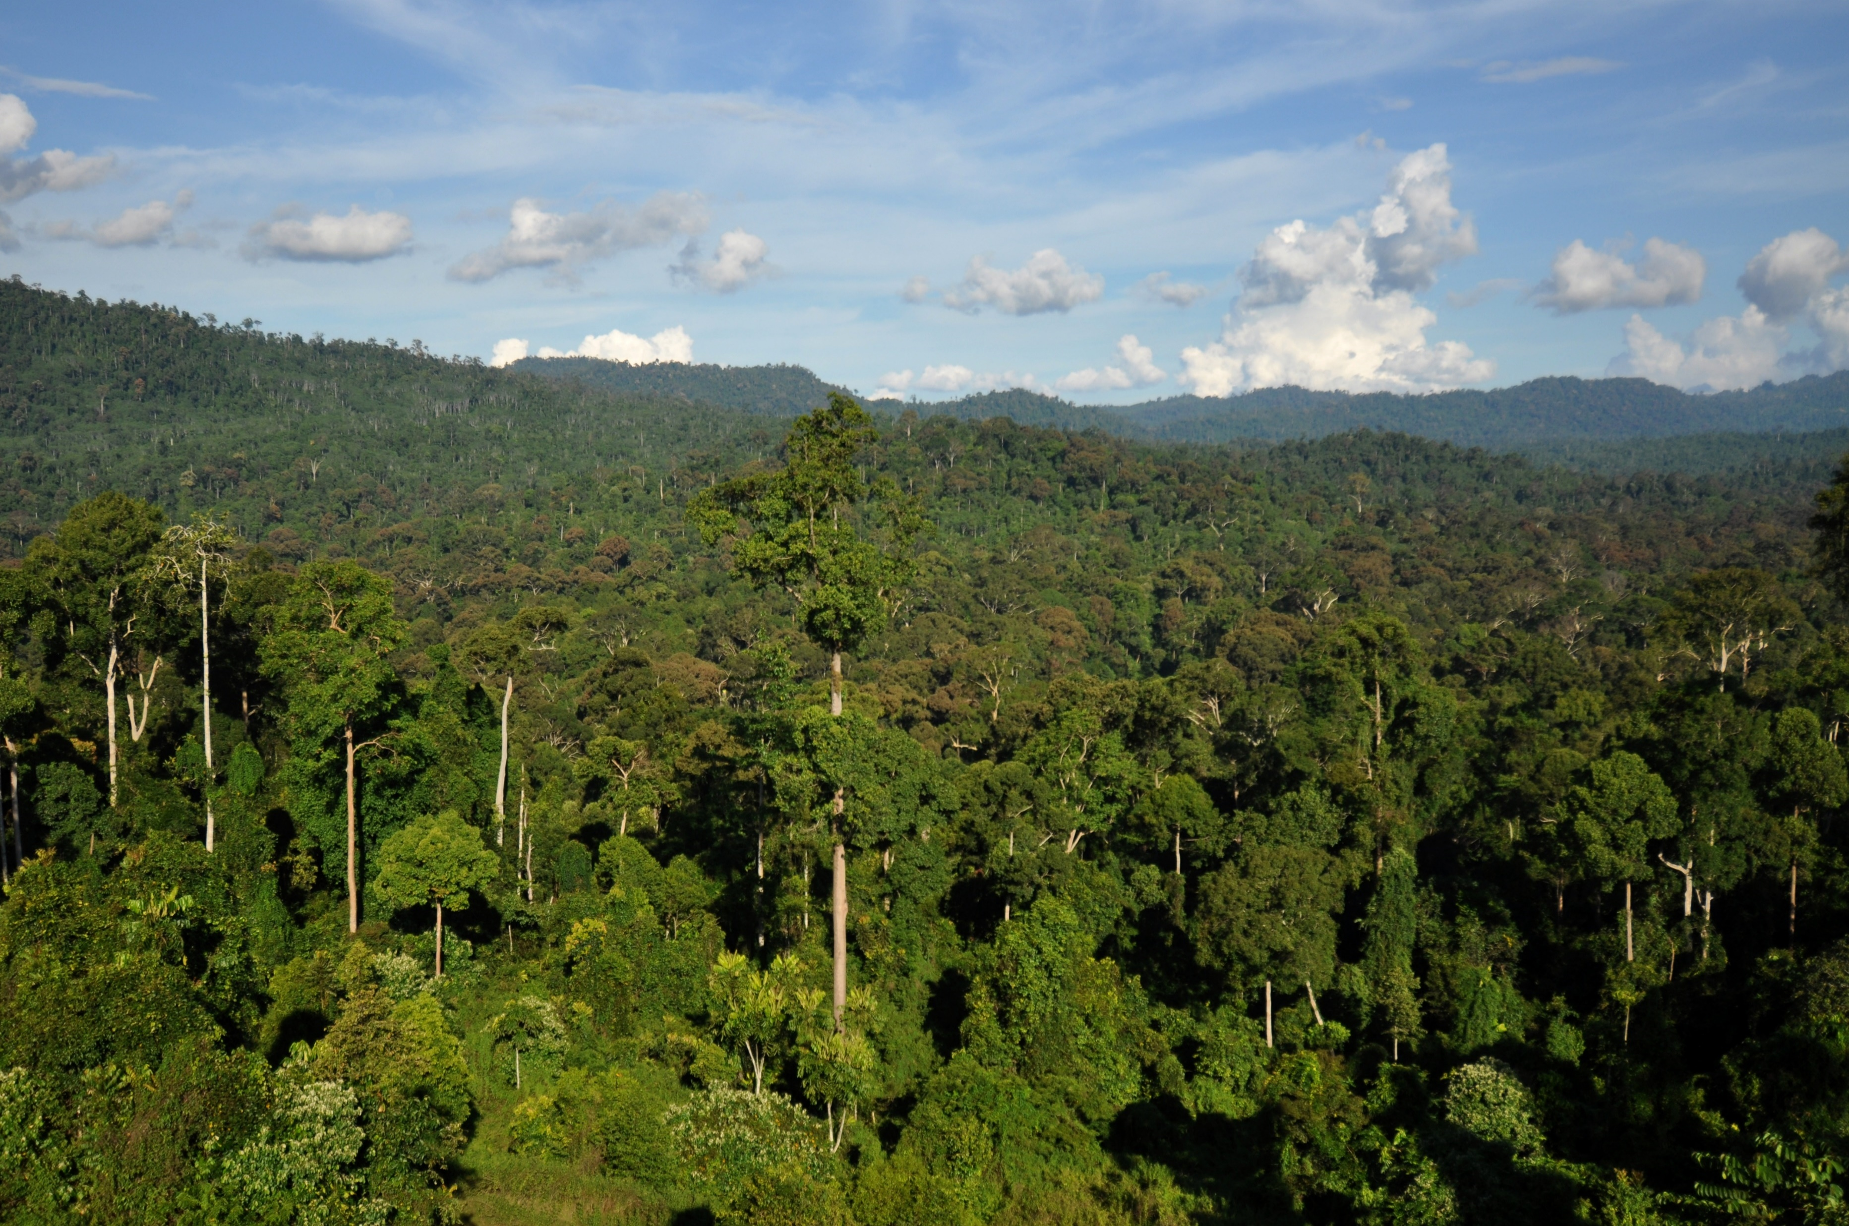
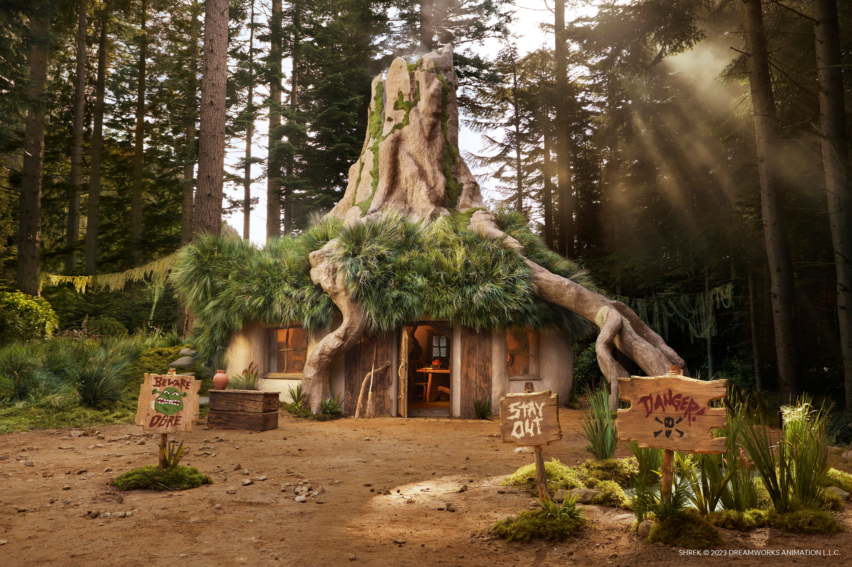
5 Areas
Plains
Mountain
Forest
Swamp
Volcano

Slide 7
Plains
The first level
Very simple first level, showing the player there are ways to shortcut rooms and making mistakes will make the player move through more rooms and must answer more questions
Link to example of the flow chart of rooms

Slide 9


Slide 10


Slide 12
Volcano
This is where you will face the final boss answering a series of riddles to defeat him
Clues will be given throughout the other 4 levels to help you complete these riddles, although these are not required they will help

